Slide 1
CAHMDA/DAFOH Ensemble Data Assimilation Tutorial

Slide 2
Who is the instructor?
Tim Hoar thoar@ucar.edu www.image.ucar.edu/~thoar
I got my Bachelors degree from a school in New York in 1983.
Several jobs and 10 years later, I graduated from University of Texas in Austin.
I worked in the Geophysical Statistics Project at the U.S. National Center for Atmospheric Research (NCAR) for about 10 years.
I’ve been working with Jeff Anderson and the rest of the Data Assimilation Research Section at NCAR for about 10 years.

Slide 3
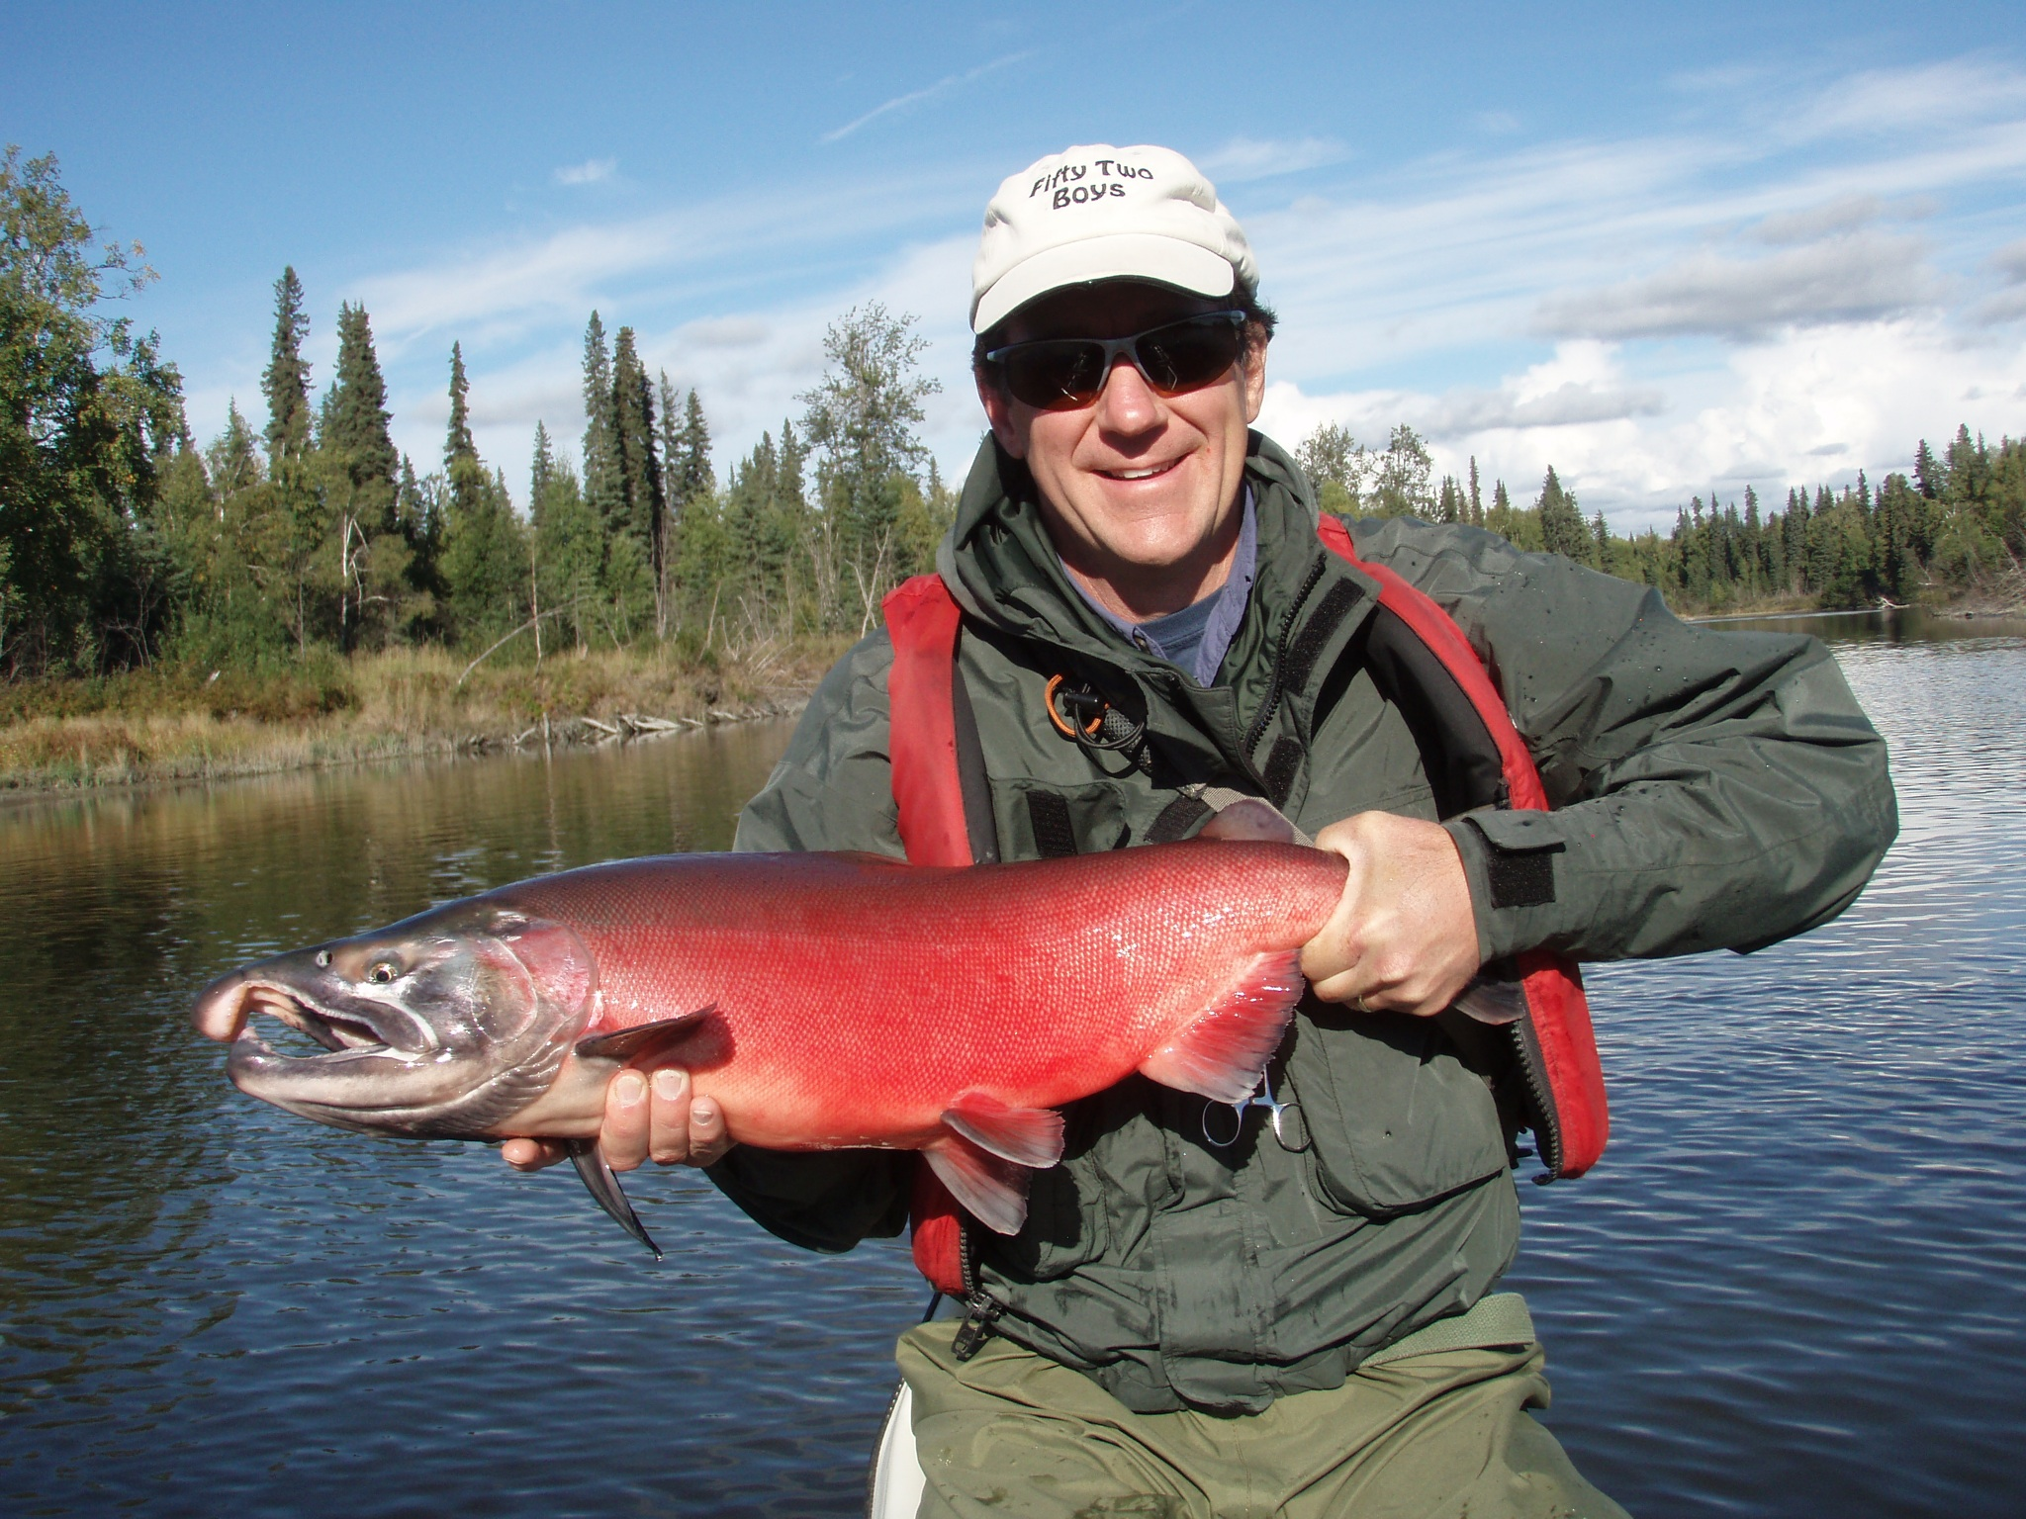
But Really … I just love to fish!

Slide 4
Who is the instructor?
Something to think about all day …
One statement is a lie.
I have been to all 7 continents.
I was the president of the UT Austin dart league. (as in the pub game, not the software)
I can lift a canoe over my head with one hand.
Here is a hint:

Slide 5
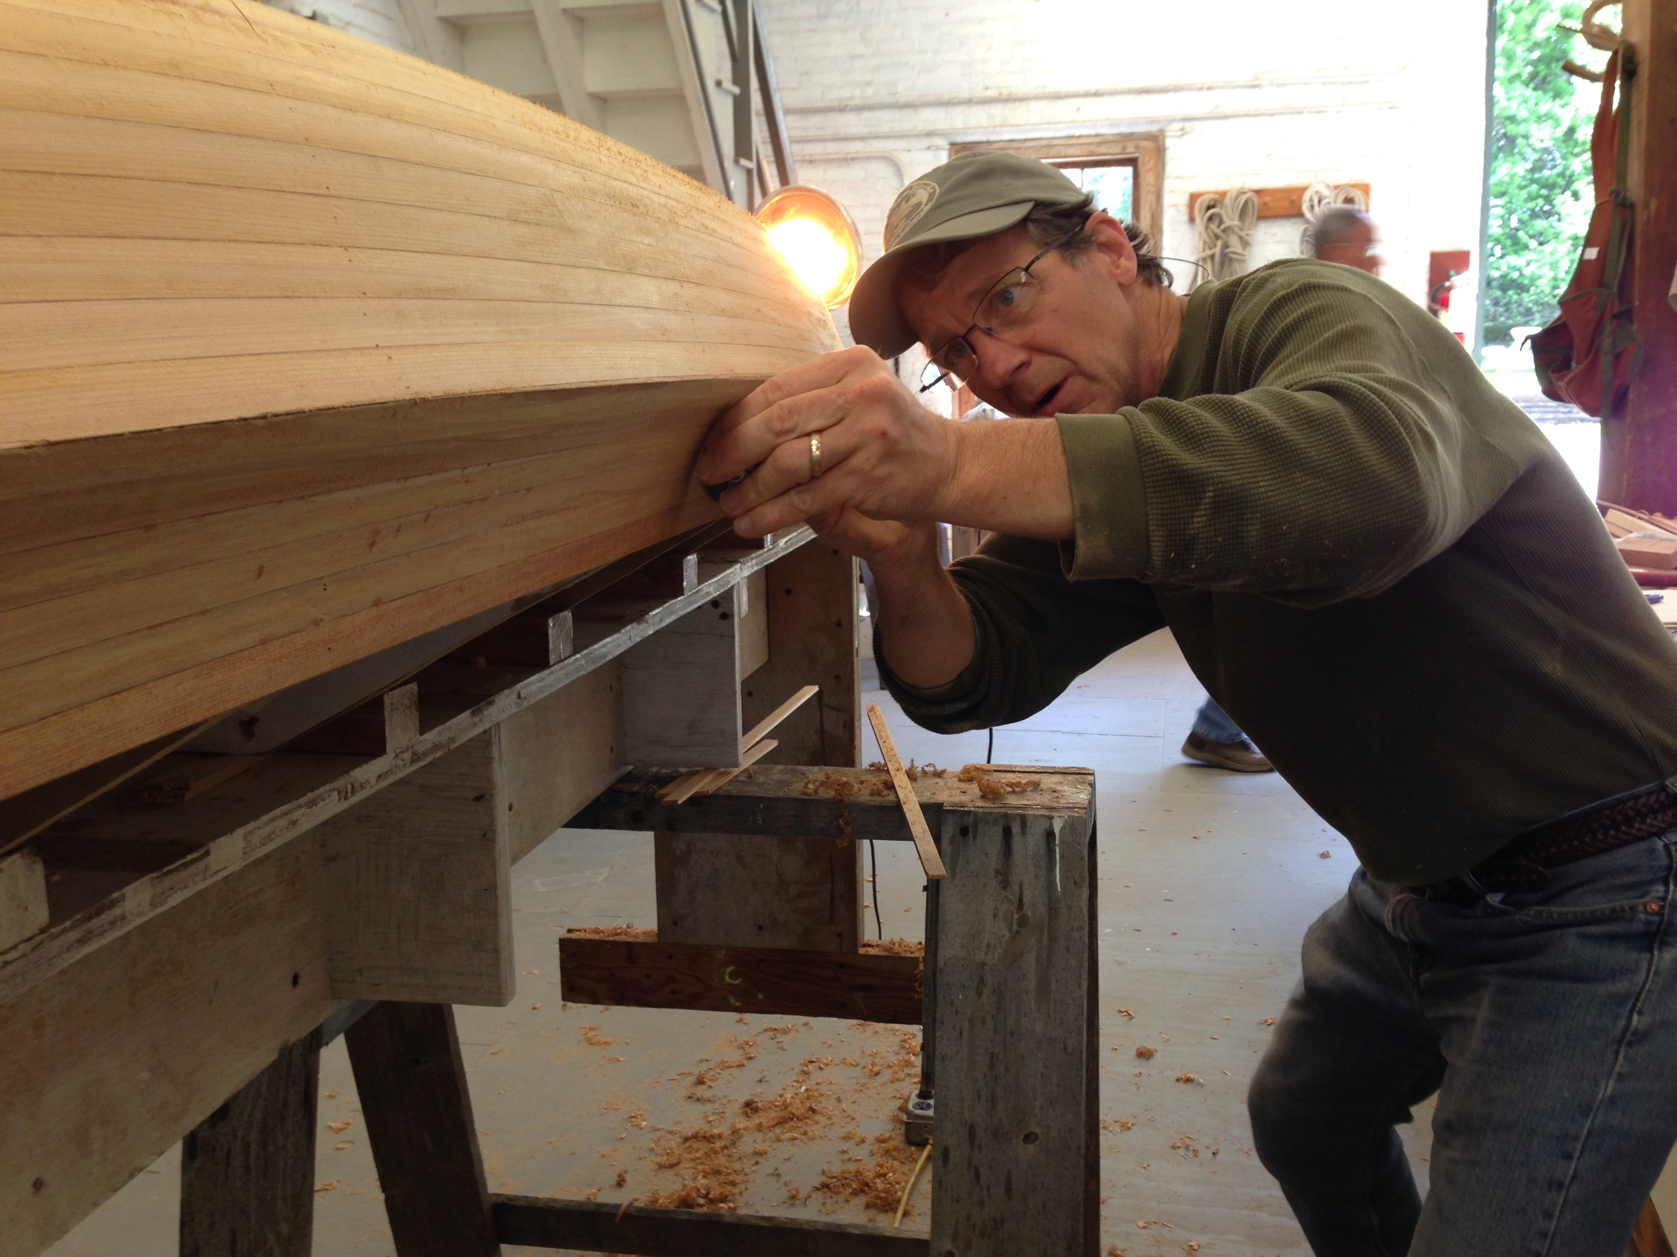
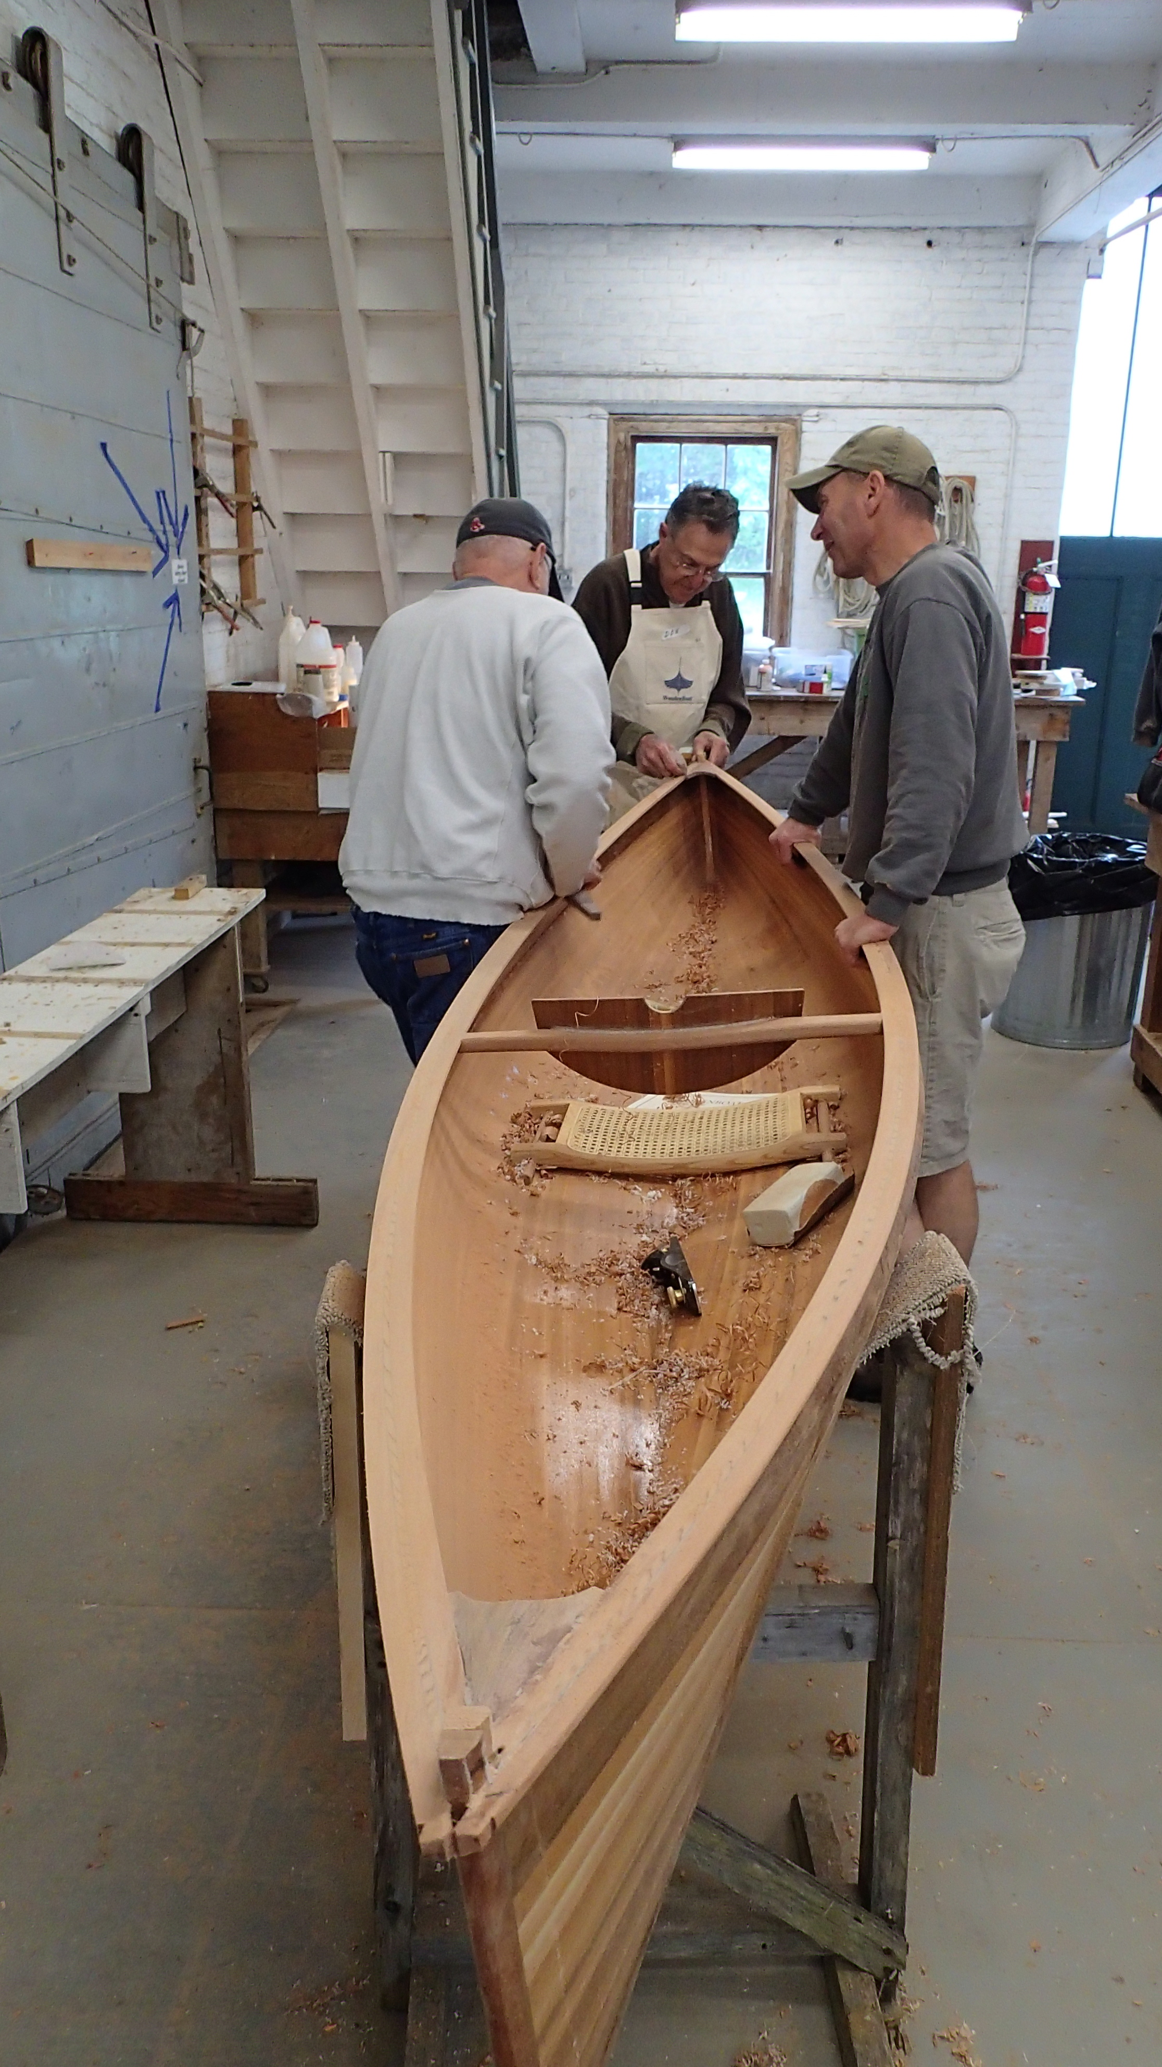
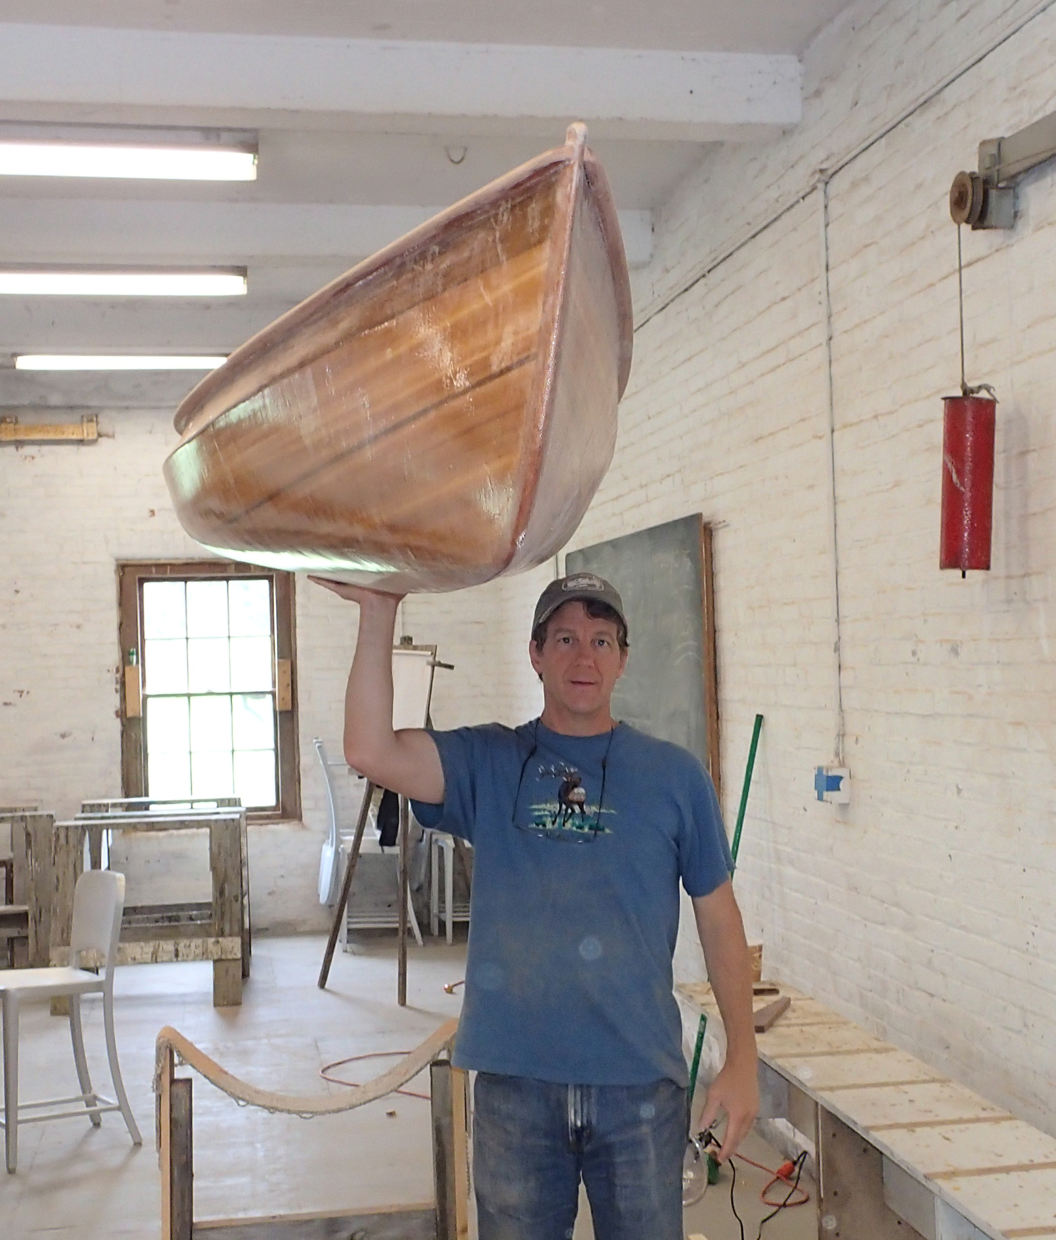
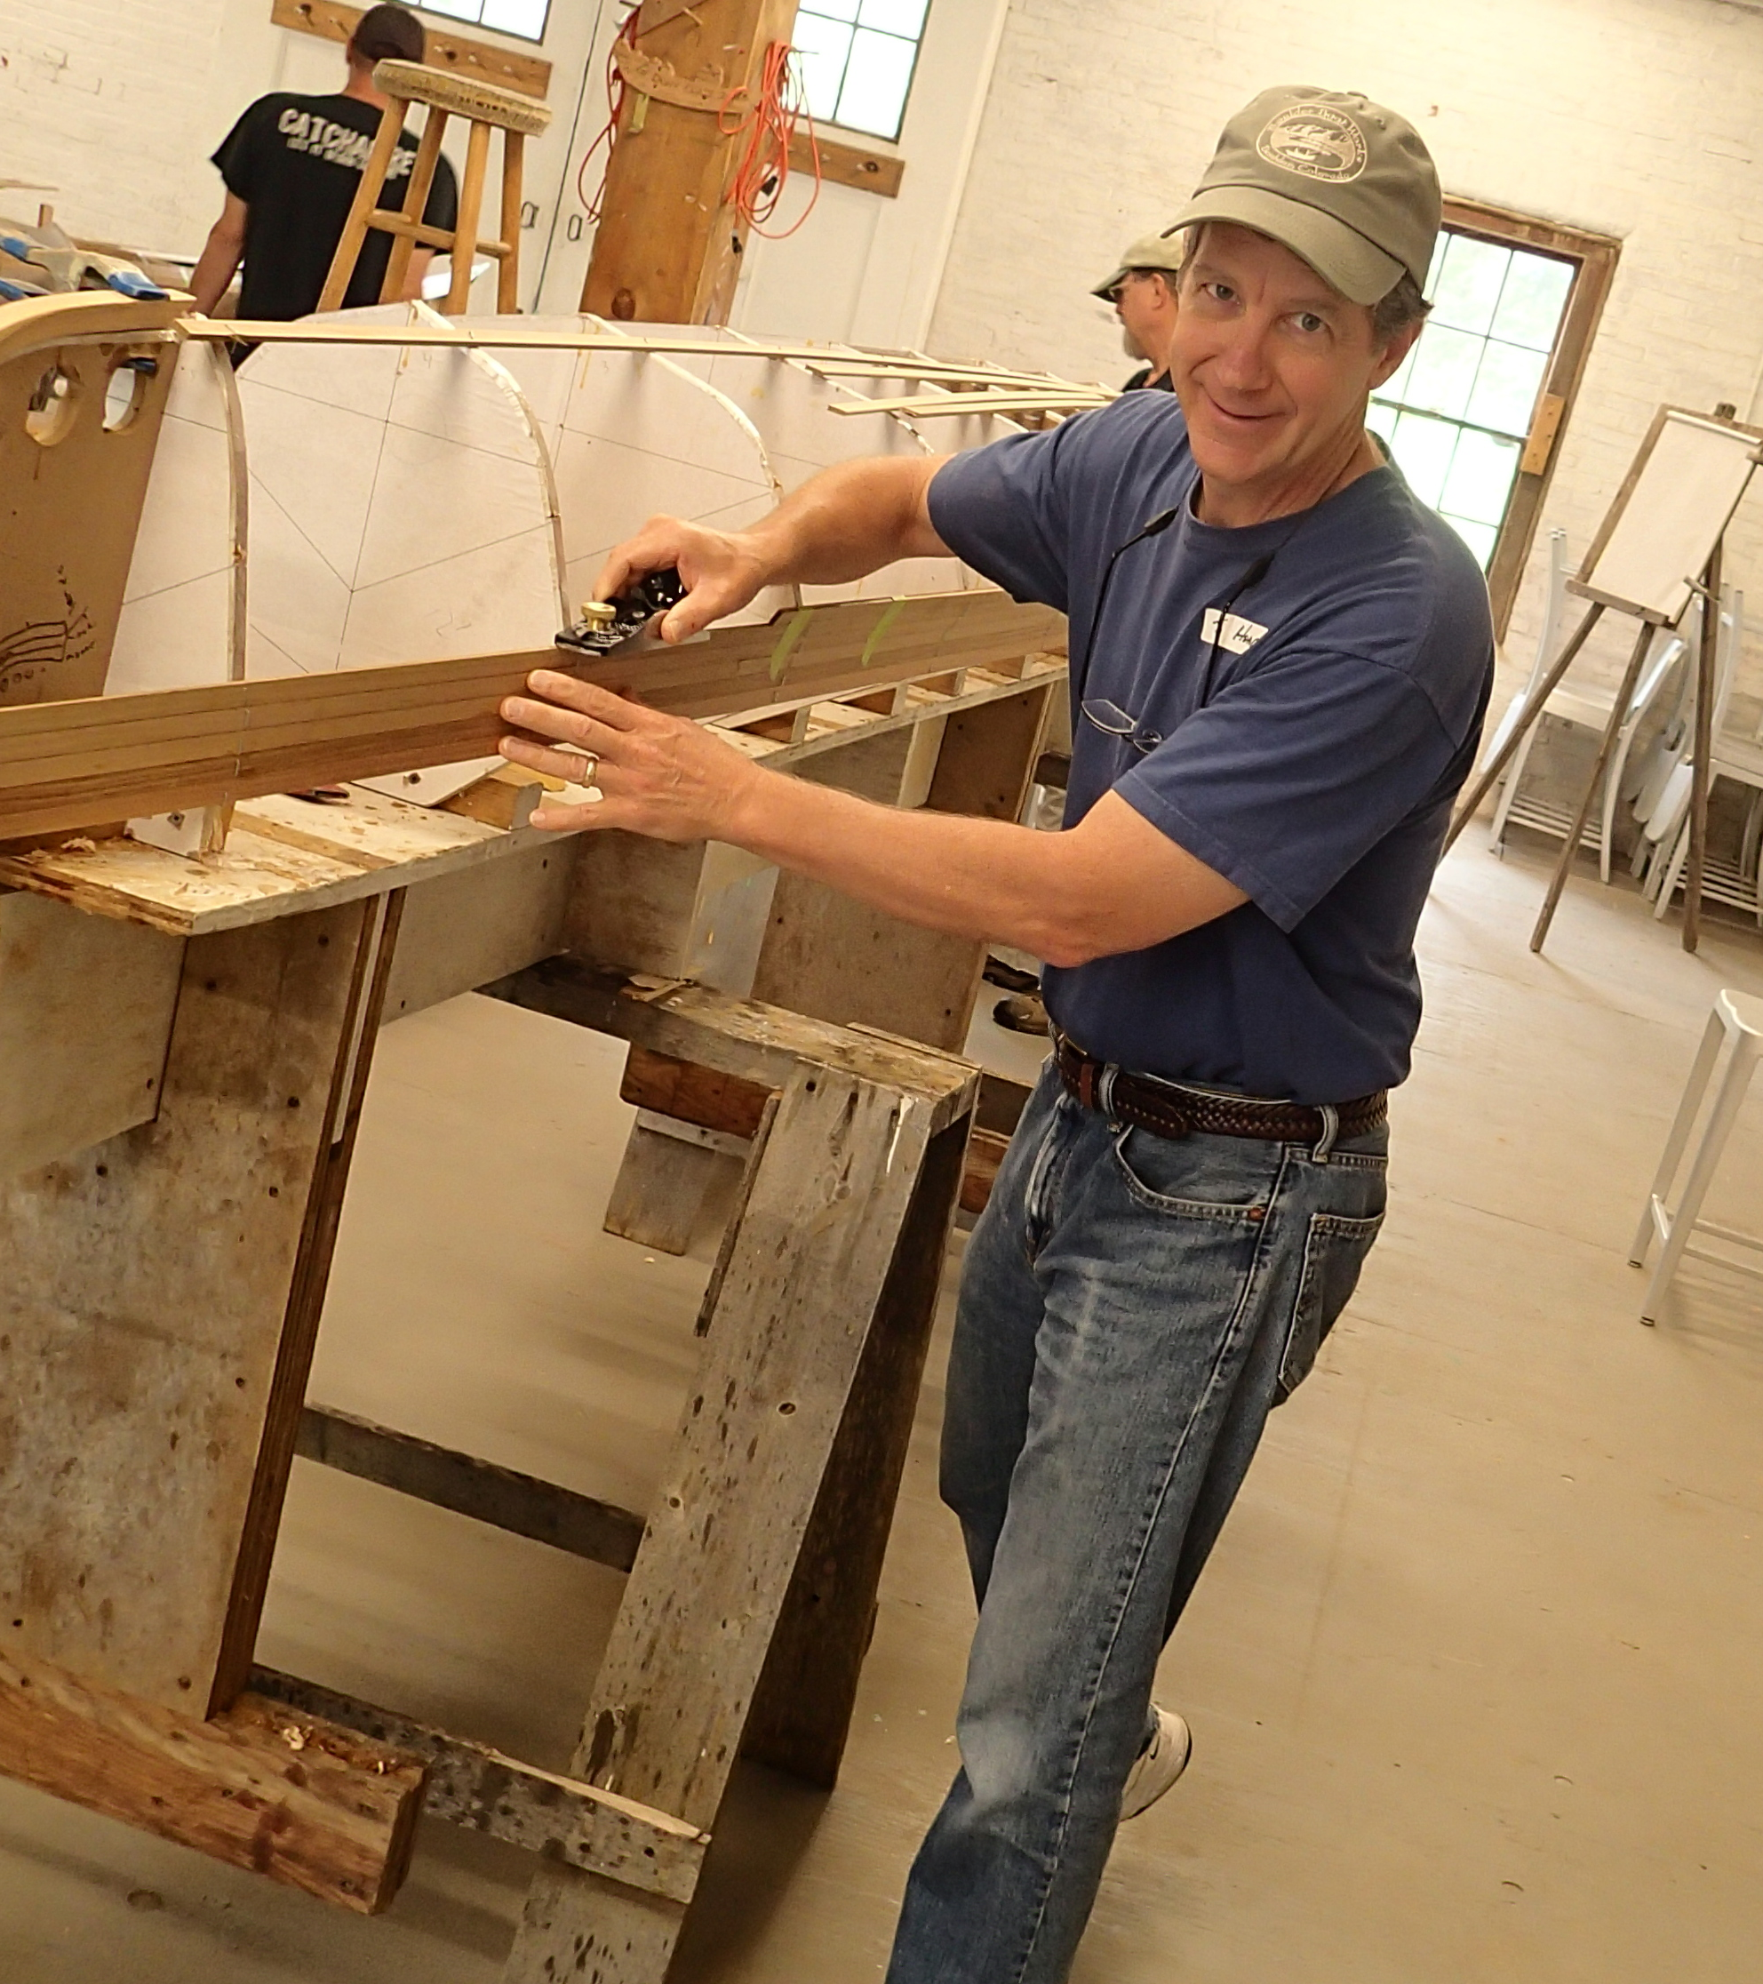
It’s actually a very light canoe! (10kg)
Notes:
s01f01.eps

Slide 6
What to expect for today:
I want this to be a fun, engaging, informative, interactive day!
I expect you to ASK QUESTIONS! Please! I’ve heard everything I’m going to say!
I need you to help guide the tutorial. This is an audience participation day. I am not going to be a talking head for 8 hours. That is most definitely NOT ME!

Slide 7
Introductions:
Yes, we are going to go around the room and introduce ourselves. As you introduce yourself, please:
Tell us your name and where you’re from.
What, if any, (land or hydrological) model you are most familiar with.
What you hope to get out of this tutorial.

Slide 8
DART “home page”:
http://www.image.ucar.edu/DAReS/DART
The most useful (to me) pull-down menus:
Getting Started
Documentation
Diagnostics
Miscellany: Platform-specific Notes
Overview article of DART:
Anderson, Jeffrey, T. Hoar, K. Raeder, H. Liu, N. Collins, R. Torn, A. Arellano, 2009: The Data Assimilation Research Testbed: A Community Facility.
Bull. Amer. Meteor. Soc., 90, 1283–1296. doi:10.1175/2009BAMS2618.1
CAHMDA-V July 2012 pg 8

Slide 9

Some Research using DART & land models
DART Multiple Component Data Assimilation
Started with CCSM4 20th Century 30-member ensemble for all model components
COUPLER
CAM
Important!
There are multiple instances of each model component.
CLM
POP
Abhishek
Chatterjee is doing
this now!
DART
DART
DART
DART
observations
ROF
CICE
DART assimilates
observations into components separately

Slide 10

Some of the researchers using CLM/DART
Yong-Fei Zhang (UT Austin)
multisensor snow data assimilation
Andy Fox (NEON)
flux observations/state estimation
Hanna Post (Jülich)
assimilation & parameter estimation
Raj Shekhar Singh (UC Berkeley)
groundwater
Long Zhao (UT Austin)
AMSR-E radiances, empirical vegetated surface RTM, soil moisture (SMAP)
Ally Toure (NASA-Goddard USRA)
brightness temperatures
Yonghwan Kwon (UT Austin)
sensitivity of assimilation of brightness temperatures from multiple
radiative transfer models on estimates of snow water equivalent.
Notes:
For the past months, I have been trying to assimilating AMSR-E radiance (Descending orbit, 10.6 GHz, H- and V- polarization) into CLM to estimate global soil mositure (1.25 degree x 0.9 degree). Thanks to your help, up to now, I have already successfully coupled an empricial vegetated-surface radiative transfer model into DART-CLM, prepared all the input datasets, and got the assimilation run effectively (with 20 ensembles for test run). Currently, I am working on some technical problems and testing the system as well. I will keep you updated on the first results together with more details on what I have done within the following weeks.
Wish you all the best,
Sincerely,
Long

Slide 11

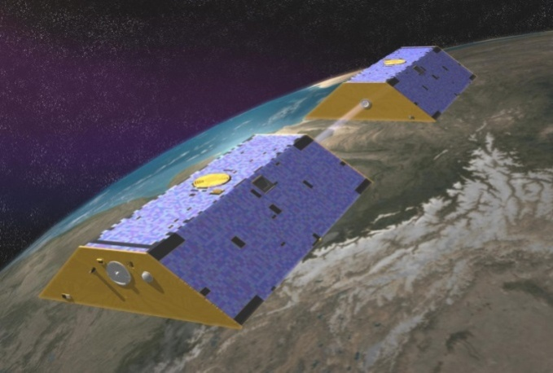
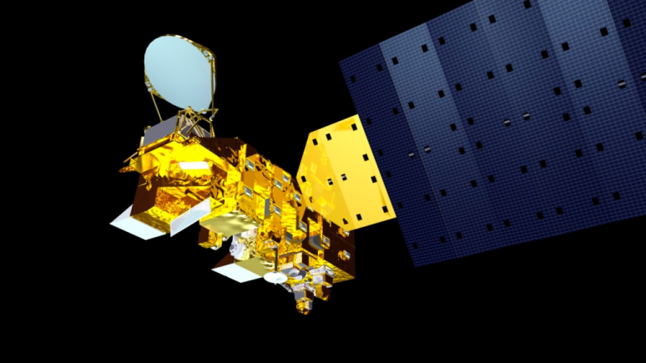




Improving Estimates of Snowpack Water Storage in the Northern Hemisphere Through a Newly Developed Land Data Assimilation System
Yong-Fei Zhang¹, Zong-Liang Yang^{1,2}, Yonghwan Kwon¹, Tim J. Hoar³, Hua Su¹, Jeffrey L. Anderson ³, Ally M. Toure ^{4,5}, and Matthew Rodell ⁵
¹Jackson School of Geosciences, University of Texas at Austin, Austin, TX, United States.
²Key Lab of Regional Climate-Environment for Temperate East Asia (RCE-TEA), Institute of Atmospheric Physics, Chinese Academy of Sciences, Beijing, China.
³The National Center for Atmospheric Research, Boulder, CO, United States.
⁴Universities Space Research Association (USRA), Columbia, MD, United States.
⁵NASA Goddard Space Flight Center, Greenbelt, MD, United States.

Slide 12
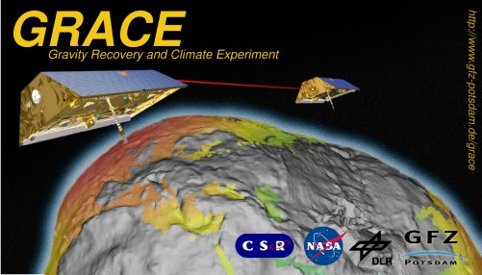
GRACE satellite data
Different from MODIS that measures radiances, GRACE measures the distance between two satellites and retrieves gravitational anomalies. One of the products is a change in monthly total water storage (TWS).

Slide 13
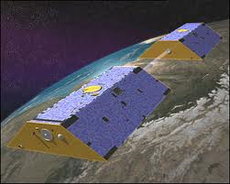
Two passes in GRACE data assimilation
CLM4
CLM4
CLM4
CLM4
CLM4
CLM4
…
Monthly TWS
GRACE ‘Obs’
DART
Analysis
Run CLM for one month to be able to calculate change in monthly total water storage.
Re-run CLM with data assimilation.
Notes:
Grace “observations” … change in total water storage from one month to the next ? Climate Modeler’s Golden Rule refers to “good observations …” … these are highly derived products.
How much information can we tease out of them?

Slide 14
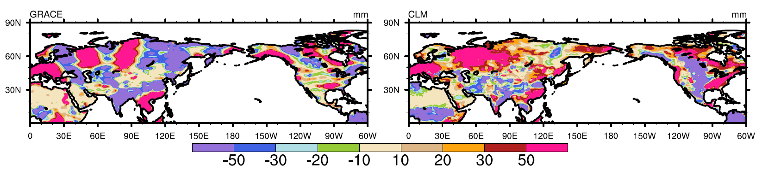
Total Water Storage change Jan 2003
No assimilation.
GRACE
CLM
mm

Slide 15
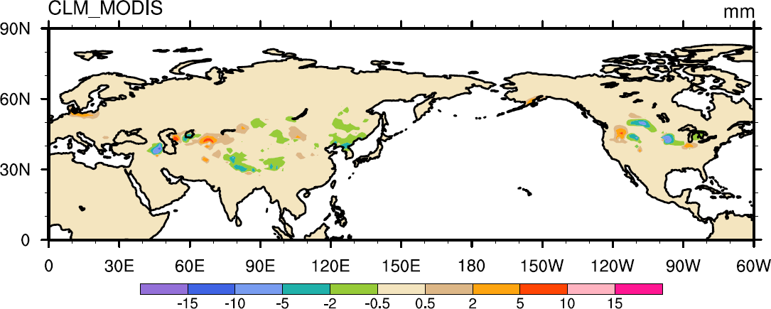
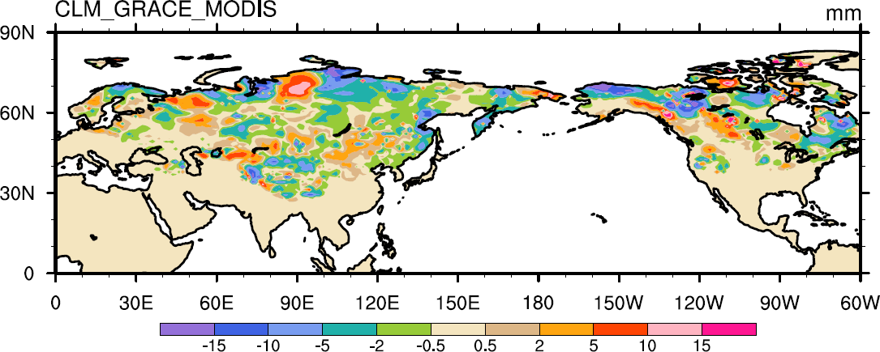
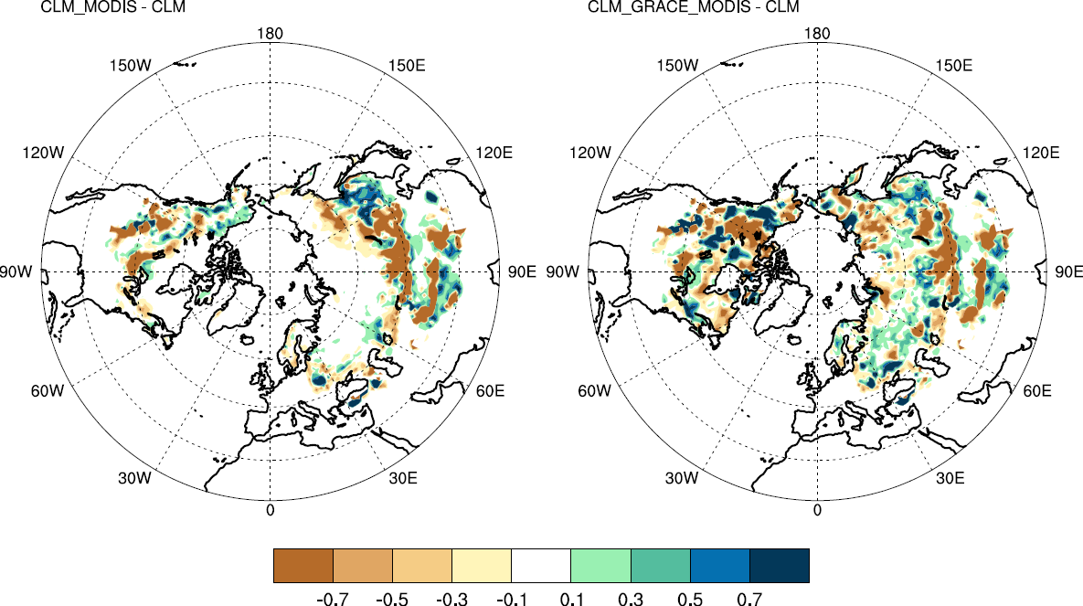
Assimilation Results
Snow Water Storage (Posterior minus Prior)
MODIS assimilation
MODIS and GRACE assimilation

Slide 16
Multi-RTM ensemble approaches in SWE assimilation. Yonghwan Kwon, UT Austin
Develop an advanced radiance assimilation scheme to estimate SWE at continental scale by using multiple snowpack RTMs:
Microwave Emission Model for Layered Snowpacks (MEMLS) and
Dense Media Radiative Transfer – Multi Layers model (DMRT-ML).
CLM4 &
MEMLS
18.7-V
18.7-H
36.5-V
36.5-H
Correlations
between:
CLM4 &
DMRT-ML
MEMLS; Wiesmann and Mätzler, 1999
DMRT-ML; Picard et al., 2013
TJH CESM 2014 pg 16
Notes:
Part of a poster by Liang for the 2013 AGU.
The relationship between SWE assimilation results and AMSR-E TB at continental scale. Please refer to poster H51I-1324 by Kwon et al. (Hydrology session, Friday, Moscone South, Hall A-C) for more information.
Radiance assimilation (RA) has shown promise for improving snow water equivalent (SWE) estimates. For RA, the radiative transfer model (RTM) should be incorporated into a data assimilation system as an observational operator predicting brightness temperature (Tb) and thus the quality of the assimilation results may be strongly affected by the uncertainty of the RTM. As a preliminary study for a successful data assimilation, in this study, we aim to analyze the error characteristics of the coupled land surface-radiative transfer models (LSM/RTMs); for this, we used the Community Land Model version 4 (CLM4) and two snowpack RTMs, Microwave Emission Model for Layered Snowpacks (MEMLS) and the Dense Media Radiative Transfer - Multi Layers model (DMRT-ML). We characterized the errors of the coupled CLM4/DMRT-ML and CLM4/MEMLS by comparing their performance in simulating snowpack states and Tb, and by analyzing the correlations between SWE and Tb errors. SWE simulations by CLM4 show fairly good agreement with the observations for the NASA Cold Land Processes Field Experiment (CLPX) Local Scale Observation Site (LSOS) (point-scale and non-vegetated case); however, mainly due to the lack of precipitation data, SWE is overestimated for the Fraser Meso-cell Study Areas (MSAs) and underestimated for the Rabbit Ears MSA (local-scale and vegetated case). Both the coupled models show comparable performance in predicting Tb at 18.7 and 36.5 GHz vertical (V) and horizontal (H) polarization channels; the performances of CLM4/DMRT-ML and CLM4/MEMLS are slightly better for the Rabbit Ears MSA and Fraser MSA, respectively. Over the LSOS, CLM4/DMRT-ML shows better performance for 18.7-H while CLM/MEMLS shows better performance for 36.5-V. The results in this study show that the correlation between errors of SWE and Tb is not always in the same direction: low correlation for the LSOS, negative correlation for the Fraser MSA, and positive correlation for the Rabbit Ears MSA. Our analyses suggest that the grain radius error is the potential source of correlations between SWE and Tb errors and thus the success of SWE update in RA scheme can be significantly influenced by the grain radius error. Error characteristics of the coupled models at the continental-scale are also analyzed.

Slide 17

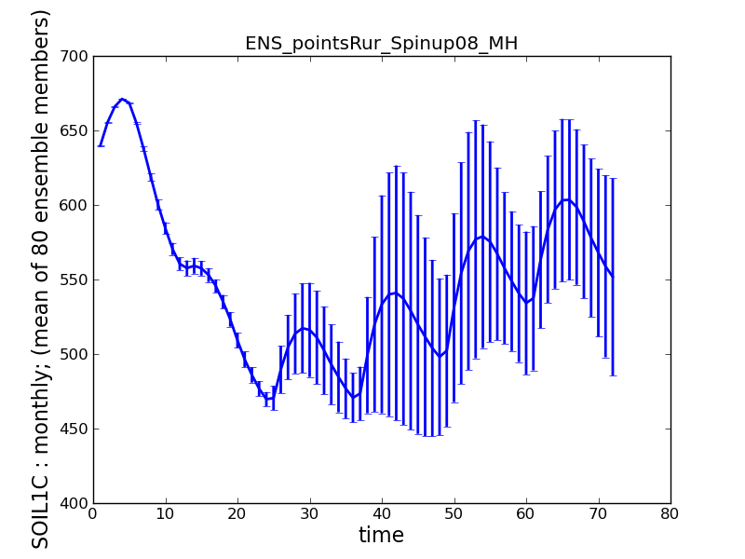
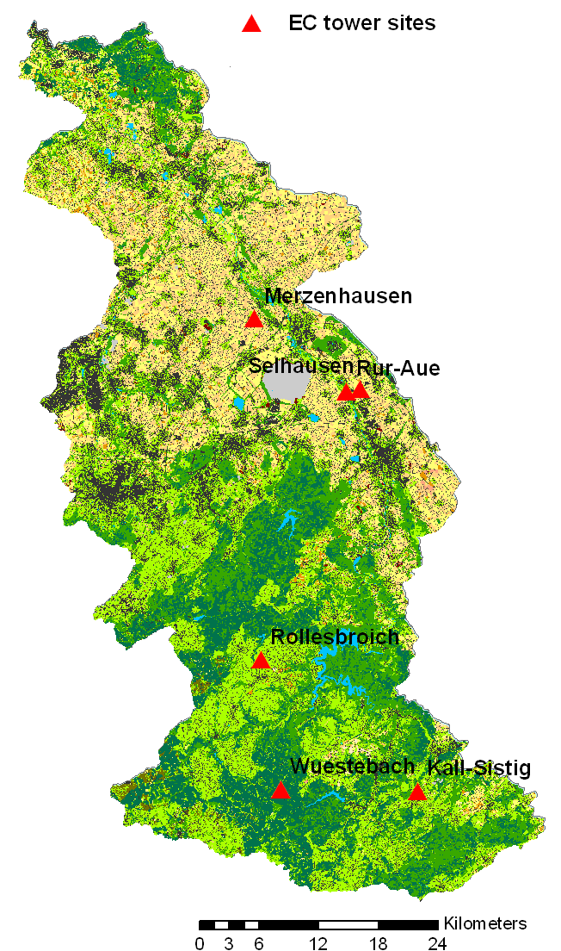
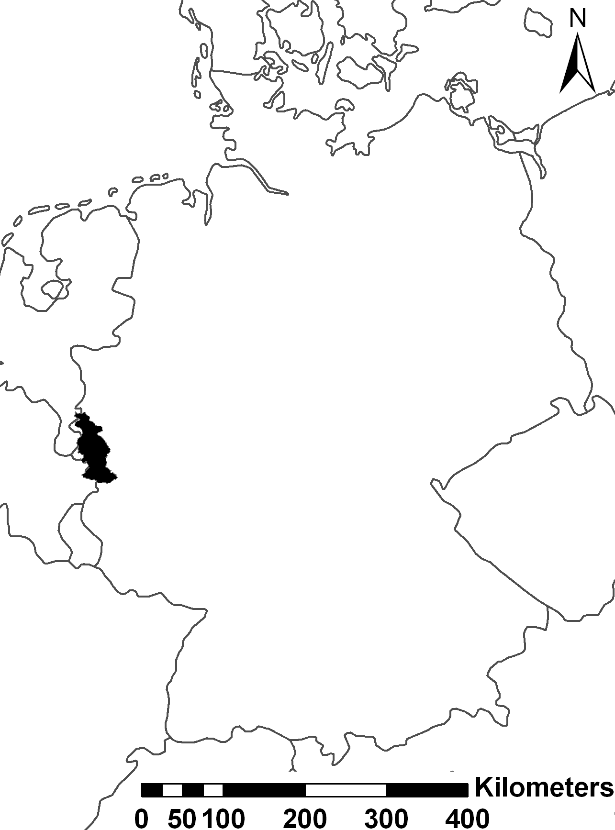
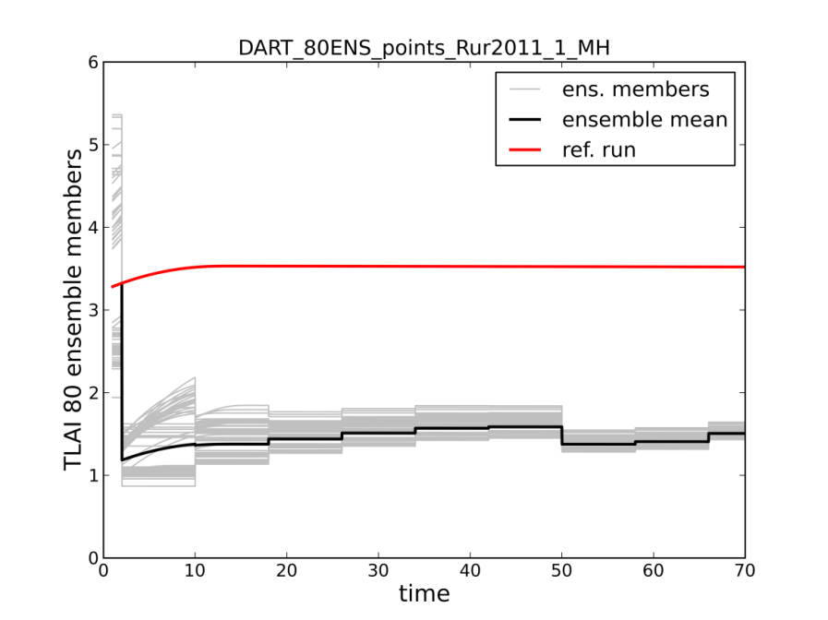
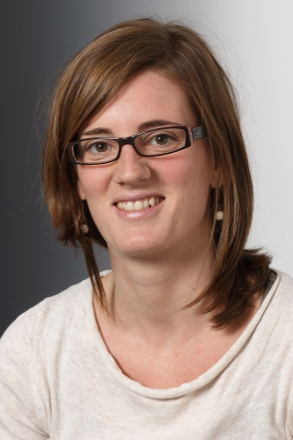
Assimilation of eddy covariance fluxes & MODIS LAI data and CLM upscale NEE from plot to catchment scale
Hanna Post visited Gordon Bonan, Andy Fox and me for 3 months earlier this year.
Notes:
In Rur-catchment: different eddy covariance (EC) towers on sites of different land use measuring net carbon and energy fluxes
Upper plot: second spinup (6 years) with perturbed climate forcings to generate perturbed initial states
Bottom plot: assimilation of LAI data (Data not plotted here). The reference run is also the ensemble mean but without data assimilation.
Parameters will be estimated with DREAM (and DART)
States will be estimated with DART, but assimilation of EC fluxes to update states is challenging, because EC fluxes are not states → sensitivity / linear correlation of fluxes states that can be updated instead is required.

Slide 18
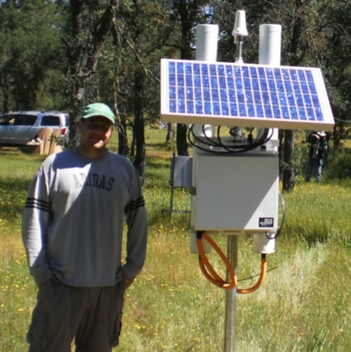
NOAH-DART: Integrated Soil Moisture

Slide 19

For more information:
CAM
ROMS
WRF
GITM
wrfHydro
WACCM
CLM
POP
AM2
BGRID
COAMPS
www.image.ucar.edu/DAReS/DART
dart@ucar.edu
NOAH
MPAS_ATM
MITgcm_ocean
COAMPS_nest
MPAS_OCN
TIEGCM
SQG
NAAPS
PBL_1d
NCOMMAS
PE2LYR
CABLE

