Slide 1
Ensemble Data Assimilation and Uncertainty Quantification
Jeffrey Anderson, Alicia Karspeck, Tim Hoar,
Nancy Collins, Kevin Raeder, Steve Yeager
National Center for Atmospheric Research

Slide 2

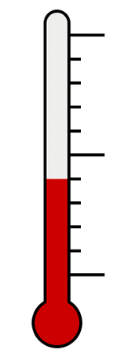
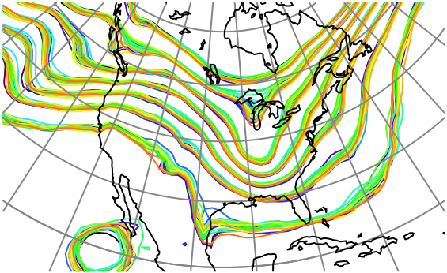
What is Data Assimilation?
Observations
Observations combined with a Model forecast…
+
…to produce an analysis
(best possible estimate).

Slide 3
What is Ensemble Data Assimilation?
Use an ensemble (set) of model forecasts.
Use sample statistics to get covariance between state and observations.
Often assume that ensemble members are random draw.
Ensemble methods I use are optimal solution when:
Model is linear,
Observation errors are unbiased gaussian,
Relation between model and obs is linear,
Ensemble is large enough.

Slide 4
Atmospheric Ensemble Reanalysis, 1998-2010
O(1 million) atmospheric obs are assimilated every day.
Assimilation uses 80 members of 2º FV CAM forced by a single ocean (Hadley+ NCEP-OI2) and produces a very competitive reanalysis.
500 hPa GPH
Feb 17 2003

Slide 5
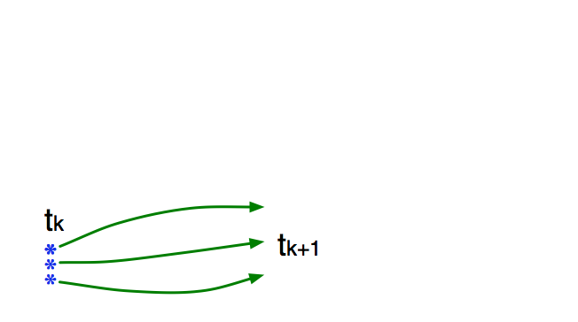
Ensemble Filter for Large Geophysical Models
1. Use model to advance ensemble (3 members here) to time at which next observation becomes available.
Ensemble state estimate after using previous observation (analysis)
Ensemble state at time of next observation (prior)

Slide 6
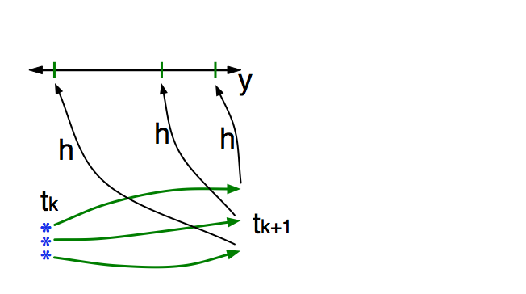
Ensemble Filter for Large Geophysical Models
2. Get prior ensemble sample of observation, y = h(x), by applying forward operator h to each ensemble member.
Theory: observations from instruments with uncorrelated errors can be done sequentially.

Slide 7
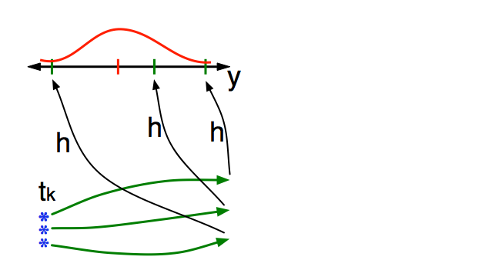
Ensemble Filter for Large Geophysical Models
3. Get observed value and observational error distribution from observing system.

Slide 8
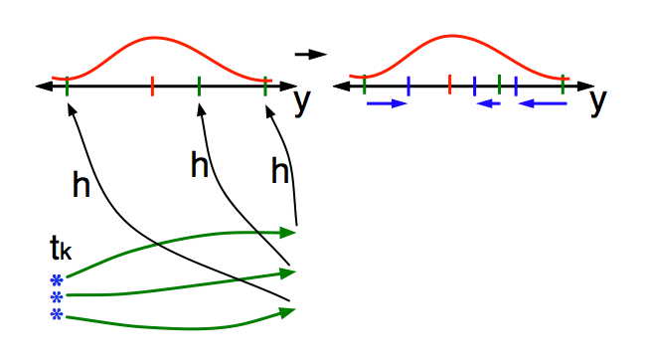
Ensemble Filter for Large Geophysical Models
4. Find the increments for the prior observation ensemble
(this is a scalar problem for uncorrelated observation errors).
Note: Difference between various ensemble filters is primarily in observation increment calculation.

Slide 9
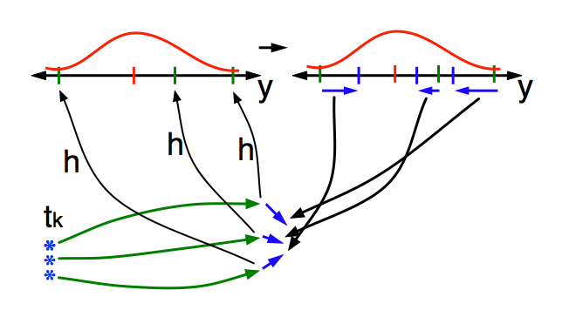
Ensemble Filter for Large Geophysical Models
5. Use ensemble samples of y and each state variable to linearly regress observation increments onto state variable increments.
Theory: impact of observation increments on each state variable can be handled independently!

Slide 10
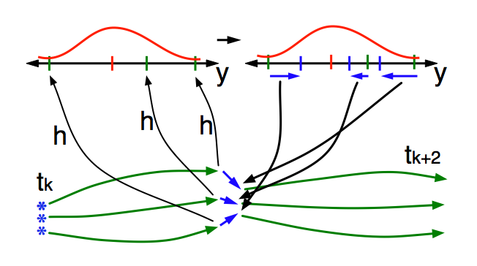
Ensemble Filter for Large Geophysical Models
6. When all ensemble members for each state variable are updated, there is a new analysis. Integrate to time of next observation …

Slide 11
Ensemble Filter for Lorenz-96 40-Variable Model
40 state variables: X1, X2,..., X40.
dXi / dt = (Xi+1 - Xi-2)Xi-1 - Xi + F.
Acts ‘something’ like synoptic weather around a latitude band.

Slide 12
Ensemble Filter for Lorenz-96 40-Variable Model
40 state variables: X1, X2,..., X40.
dXi / dt = (Xi+1 - Xi-2)Xi-1 - Xi + F.
Acts ‘something’ like synoptic weather around a latitude band.

Slide 13
Ensemble Filter for Lorenz-96 40-Variable Model
40 state variables: X1, X2,..., X40.
dXi / dt = (Xi+1 - Xi-2)Xi-1 - Xi + F.
Acts ‘something’ like synoptic weather around a latitude band.

Slide 14
Ensemble Filter for Lorenz-96 40-Variable Model
40 state variables: X1, X2,..., X40.
dXi / dt = (Xi+1 - Xi-2)Xi-1 - Xi + F.
Acts ‘something’ like synoptic weather around a latitude band.

Slide 15
Ensemble Filter for Lorenz-96 40-Variable Model
40 state variables: X1, X2,..., X40.
dXi / dt = (Xi+1 - Xi-2)Xi-1 - Xi + F.
Acts ‘something’ like synoptic weather around a latitude band.

Slide 16
Ensemble Filter for Lorenz-96 40-Variable Model
40 state variables: X1, X2,..., X40.
dXi / dt = (Xi+1 - Xi-2)Xi-1 - Xi + F.
Acts ‘something’ like synoptic weather around a latitude band.

Slide 17
Ensemble Filter for Lorenz-96 40-Variable Model
40 state variables: X1, X2,..., X40.
dXi / dt = (Xi+1 - Xi-2)Xi-1 - Xi + F.
Acts ‘something’ like synoptic weather around a latitude band.

Slide 18
Ensemble Filter for Lorenz-96 40-Variable Model
40 state variables: X1, X2,..., X40.
dXi / dt = (Xi+1 - Xi-2)Xi-1 - Xi + F.
Acts ‘something’ like synoptic weather around a latitude band.

Slide 19
Ensemble Filter for Lorenz-96 40-Variable Model
40 state variables: X1, X2,..., X40.
dXi / dt = (Xi+1 - Xi-2)Xi-1 - Xi + F.
Acts ‘something’ like synoptic weather around a latitude band.

Slide 20
Ensemble Filter for Lorenz-96 40-Variable Model
40 state variables: X1, X2,..., X40.
dXi / dt = (Xi+1 - Xi-2)Xi-1 - Xi + F.
Acts ‘something’ like synoptic weather around a latitude band.

Slide 21
Lorenz-96 is sensitive to small perturbations
Introduce 20 ‘ensemble’ state estimates.
Each is slightly perturbed for each of the 40-variables at time 100.
Refer to unperturbed control integration as ‘truth’..

Slide 22
Lorenz-96 is sensitive to small perturbations
Introduce 20 ‘ensemble’ state estimates.
Each is slightly perturbed for each of the 40-variables at time 100.
Refer to unperturbed control integration as ‘truth’..

Slide 23
Lorenz-96 is sensitive to small perturbations
Introduce 20 ‘ensemble’ state estimates.
Each is slightly perturbed for each of the 40-variables at time 100.
Refer to unperturbed control integration as ‘truth’..

Slide 24
Lorenz-96 is sensitive to small perturbations
Introduce 20 ‘ensemble’ state estimates.
Each is slightly perturbed for each of the 40-variables at time 100.
Refer to unperturbed control integration as ‘truth’..

Slide 25
Lorenz-96 is sensitive to small perturbations
Introduce 20 ‘ensemble’ state estimates.
Each is slightly perturbed for each of the 40-variables at time 100.
Refer to unperturbed control integration as ‘truth’..

Slide 26
Lorenz-96 is sensitive to small perturbations
Introduce 20 ‘ensemble’ state estimates.
Each is slightly perturbed for each of the 40-variables at time 100.
Refer to unperturbed control integration as ‘truth’..

Slide 27
Lorenz-96 is sensitive to small perturbations
Introduce 20 ‘ensemble’ state estimates.
Each is slightly perturbed for each of the 40-variables at time 100.
Refer to unperturbed control integration as ‘truth’..

Slide 28
Lorenz-96 is sensitive to small perturbations
Introduce 20 ‘ensemble’ state estimates.
Each is slightly perturbed for each of the 40-variables at time 100.
Refer to unperturbed control integration as ‘truth’..

Slide 29
Lorenz-96 is sensitive to small perturbations
Introduce 20 ‘ensemble’ state estimates.
Each is slightly perturbed for each of the 40-variables at time 100.
Refer to unperturbed control integration as ‘truth’..

Slide 30
Lorenz-96 is sensitive to small perturbations
Introduce 20 ‘ensemble’ state estimates.
Each is slightly perturbed for each of the 40-variables at time 100.
Refer to unperturbed control integration as ‘truth’..

Slide 31
Lorenz-96 is sensitive to small perturbations
Introduce 20 ‘ensemble’ state estimates.
Each is slightly perturbed for each of the 40-variables at time 100.
Refer to unperturbed control integration as ‘truth’..

Slide 32
Lorenz-96 is sensitive to small perturbations
Introduce 20 ‘ensemble’ state estimates.
Each is slightly perturbed for each of the 40-variables at time 100.
Refer to unperturbed control integration as ‘truth’..

Slide 33
Lorenz-96 is sensitive to small perturbations
Introduce 20 ‘ensemble’ state estimates.
Each is slightly perturbed for each of the 40-variables at time 100.
Refer to unperturbed control integration as ‘truth’..

Slide 34
Lorenz-96 is sensitive to small perturbations
Introduce 20 ‘ensemble’ state estimates.
Each is slightly perturbed for each of the 40-variables at time 100.
Refer to unperturbed control integration as ‘truth’..

Slide 35
Lorenz-96 is sensitive to small perturbations
Introduce 20 ‘ensemble’ state estimates.
Each is slightly perturbed for each of the 40-variables at time 100.
Refer to unperturbed control integration as ‘truth’..

Slide 36
Assimilate ‘observations’ from 40 random locations each step.
Observations generated by interpolating truth to station location.
Simulate observational error: Add random draw from N(0, 16) to each.
Start from ‘climatological’ 20-member ensemble.

Slide 37
Assimilate ‘observations’ from 40 random locations each step.
Observations generated by interpolating truth to station location.
Simulate observational error: Add random draw from N(0, 16) to each.
Start from ‘climatological’ 20-member ensemble.

Slide 38
Assimilate ‘observations’ from 40 random locations each step.
Observations generated by interpolating truth to station location.
Simulate observational error: Add random draw from N(0, 16) to each.
Start from ‘climatological’ 20-member ensemble.

Slide 39
Assimilate ‘observations’ from 40 random locations each step.
Observations generated by interpolating truth to station location.
Simulate observational error: Add random draw from N(0, 16) to each.
Start from ‘climatological’ 20-member ensemble.

Slide 40
Assimilate ‘observations’ from 40 random locations each step.
Observations generated by interpolating truth to station location.
Simulate observational error: Add random draw from N(0, 16) to each.
Start from ‘climatological’ 20-member ensemble.

Slide 41
Assimilate ‘observations’ from 40 random locations each step.
Observations generated by interpolating truth to station location.
Simulate observational error: Add random draw from N(0, 16) to each.
Start from ‘climatological’ 20-member ensemble.

Slide 42
Assimilate ‘observations’ from 40 random locations each step.
Observations generated by interpolating truth to station location.
Simulate observational error: Add random draw from N(0, 16) to each.
Start from ‘climatological’ 20-member ensemble.

Slide 43
Assimilate ‘observations’ from 40 random locations each step.
Observations generated by interpolating truth to station location.
Simulate observational error: Add random draw from N(0, 16) to each.
Start from ‘climatological’ 20-member ensemble.

Slide 44
Assimilate ‘observations’ from 40 random locations each step.
Observations generated by interpolating truth to station location.
Simulate observational error: Add random draw from N(0, 16) to each.
Start from ‘climatological’ 20-member ensemble.

Slide 45
Assimilate ‘observations’ from 40 random locations each step.
This isn’t working very well.
Ensemble spread is reduced, but...,
Ensemble is inconsistent with truth most places.
Confident and wrong.
Confident and right.

Slide 46
Some Error Sources in Ensemble Filters
3. Observation error
4. Sampling Error;
Gaussian Assumption
2. Obs. operator error;
Representativeness
5. Sampling Error;
Assuming Linear
Statistical Relation
1. Model error

Slide 47
Observations impact unrelated state variables through sampling error.
Plot shows expected absolute value of sample correlation vs. true correlation.
Unrelated obs. reduce spread, increase error.
Attack with localization.
Don’t let obs. Impact unrelated state.

Slide 48
Lorenz-96 Assimilation with localization of observation impact.

Slide 49
Lorenz-96 Assimilation with localization of observation impact.

Slide 50
Lorenz-96 Assimilation with localization of observation impact.

Slide 51
Lorenz-96 Assimilation with localization of observation impact.

Slide 52
Lorenz-96 Assimilation with localization of observation impact.

Slide 53
Lorenz-96 Assimilation with localization of observation impact.

Slide 54
Lorenz-96 Assimilation with localization of observation impact.

Slide 55
Lorenz-96 Assimilation with localization of observation impact.

Slide 56
Lorenz-96 Assimilation with localization of observation impact.

Slide 57
Lorenz-96 Assimilation with localization of observation impact.
This ensemble is more consistent with truth.

Slide 58
Localization computed by empirical offline computation.

Slide 59
Some Error Sources in Ensemble Filters
3. Observation error
4. Sampling Error;
Gaussian Assumption
2. Obs. operator error;
Representativeness
5. Sampling Error;
Assuming Linear
Statistical Relation
1. Model error

Slide 60
Assimilating in the presence of simulated model error.
dXi / dt = (Xi+1 - Xi-2)Xi-1 - Xi + F.
For truth, use F = 8.
In assimilating model, use F = 6.
Time evolution for first state variable shown.
Assimilating model quickly diverges from ‘true’ model.

Slide 61
Assimilating in the presence of simulated model error.
dXi / dt = (Xi+1 - Xi-2)Xi-1 - Xi + F.
For truth, use F = 8.
In assimilating model, use F = 6.

Slide 62
Assimilating in the presence of simulated model error.
dXi / dt = (Xi+1 - Xi-2)Xi-1 - Xi + F.
For truth, use F = 8.
In assimilating model, use F = 6.

Slide 63
Assimilating in the presence of simulated model error.
dXi / dt = (Xi+1 - Xi-2)Xi-1 - Xi + F.
For truth, use F = 8.
In assimilating model, use F = 6.

Slide 64
Assimilating in the presence of simulated model error.
dXi / dt = (Xi+1 - Xi-2)Xi-1 - Xi + F.
For truth, use F = 8.
In assimilating model, use F = 6.

Slide 65
Assimilating in the presence of simulated model error.
dXi / dt = (Xi+1 - Xi-2)Xi-1 - Xi + F.
For truth, use F = 8.
In assimilating model, use F = 6.

Slide 66
Assimilating in the presence of simulated model error.
dXi / dt = (Xi+1 - Xi-2)Xi-1 - Xi + F.
For truth, use F = 8.
In assimilating model, use F = 6.

Slide 67
Assimilating in the presence of simulated model error.
dXi / dt = (Xi+1 - Xi-2)Xi-1 - Xi + F.
For truth, use F = 8.
In assimilating model, use F = 6.

Slide 68
Assimilating in the presence of simulated model error.
dXi / dt = (Xi+1 - Xi-2)Xi-1 - Xi + F.
For truth, use F = 8.
In assimilating model, use F = 6.

Slide 69
Assimilating in the presence of simulated model error.
dXi / dt = (Xi+1 - Xi-2)Xi-1 - Xi + F.
For truth, use F = 8.
In assimilating model, use F = 6.

Slide 70
Assimilating in the presence of simulated model error.
dXi / dt = (Xi+1 - Xi-2)Xi-1 - Xi + F.
For truth, use F = 8.
In assimilating model, use F = 6.
This isn’t working again!
It will just keep getting worse.

Slide 71
Reduce confidence in model prior to deal with model error
Use inflation.
Simply increase prior ensemble variance for each state variable.
Adaptive algorithms use observations to guide this.

Slide 72
Assimilating with Inflation in presence of model error.
Inflation is a function of state variable and time.
Automatically selected by adaptive inflation algorithm.

Slide 73
Assimilating with Inflation in presence of model error.
Inflation is a function of state variable and time.
Automatically selected by adaptive inflation algorithm.

Slide 74
Assimilating with Inflation in presence of model error.
Inflation is a function of state variable and time.
Automatically selected by adaptive inflation algorithm.

Slide 75
Assimilating with Inflation in presence of model error.
Inflation is a function of state variable and time.
Automatically selected by adaptive inflation algorithm.

Slide 76
Assimilating with Inflation in presence of model error.
Inflation is a function of state variable and time.
Automatically selected by adaptive inflation algorithm.

Slide 77
Assimilating with Inflation in presence of model error.
Inflation is a function of state variable and time.
Automatically selected by adaptive inflation algorithm.

Slide 78
Assimilating with Inflation in presence of model error.
Inflation is a function of state variable and time.
Automatically selected by adaptive inflation algorithm.

Slide 79
Assimilating with Inflation in presence of model error.
Inflation is a function of state variable and time.
Automatically selected by adaptive inflation algorithm.

Slide 80
Assimilating with Inflation in presence of model error.
Inflation is a function of state variable and time.
Automatically selected by adaptive inflation algorithm.

Slide 81
Assimilating with Inflation in presence of model error.
Inflation is a function of state variable and time.
Automatically selected by adaptive inflation algorithm.
It can work, even in presence of severe model error.

Slide 82
Uncertainty Quantification from an Ensemble Kalman Filter
(Ensemble) KF optimal for linear model, gaussian likelihood, perfect model.
In KF, only mean and covariance have meaning.
Ensemble allows computation of many other statistics.
What do they mean? Not entirely clear.
What do they mean when there are all sorts of error? Even less clear.
Must Calibrate and Validate results.

Slide 83
Current Ocean (POP) Assimilation
Obs
DART
3D state
DATM
2D forcing
from CAM
assimilation
3D restart
POP
2D forcing
Coupler

Slide 84
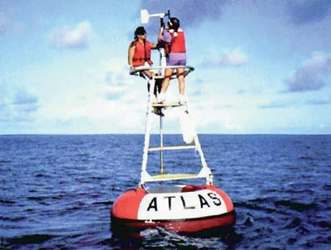
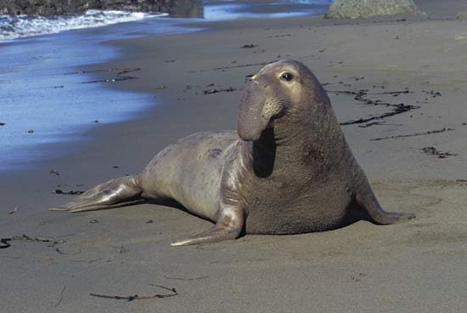
World Ocean Database T,S observation counts
These counts are for 1998 & 1999 and are representative.
FLOAT_SALINITY 68200
FLOAT_TEMPERATURE 395032
DRIFTER_TEMPERATURE 33963
MOORING_SALINITY 27476
MOORING_TEMPERATURE 623967
BOTTLE_SALINITY 79855
BOTTLE_TEMPERATURE 81488
CTD_SALINITY 328812
CTD_TEMPERATURE 368715
STD_SALINITY 674
STD_TEMPERATURE 677
XCTD_SALINITY 3328
XCTD_TEMPERATURE 5790
MBT_TEMPERATURE 58206
XBT_TEMPERATURE 1093330
APB_TEMPERATURE 580111
temperature observation error standard deviation == 0.5 K.
salinity observation error standard deviation == 0.5 msu.

Slide 85
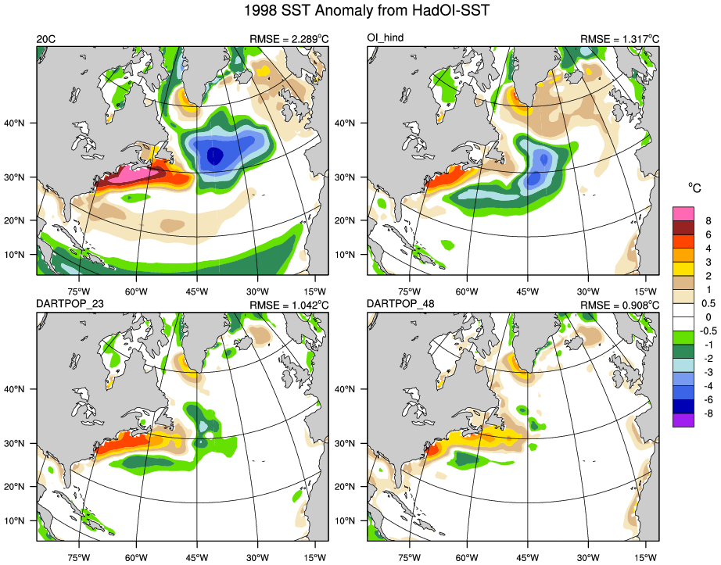
Physical Space: 1998/1999 SST Anomaly from HadOI-SST
POP forced by observed atmosphere (hindcast)
Coupled Free Run
Ensemble Assimilation
48 POP oceans
Forced by 48 CAM reanalyses

Slide 86
Challenges where ocean model is unable, or unwilling, to simulate reality.
Example: cross section along Kuroshio; model separates too far north.
Regarded to be accurate.
Free run of POP, the warm water is too far North.
Notes:
Alicia explored a bit and found the same thing was happening in another boundary current. This is the 2000-2005 mean SST in Kuroshio Current region, 143.5E transect in dashed line. The true Kuroshio separates from the coast of Japan at a lower latitude than the POP simulations, sharpening the front at 143.5E 35N and positioning it farther to the south. (POPSST is with No Assimilation)

Slide 87
Challenges in correcting position of Kuroshio.
60-day assimilation starting from model climatology on 1 January 2004.
Temperature
Temperature
Temperature
time = 10days
time = 20days
time = 30days
Latitude
Latitude
Latitude
Initially warm water goes too far north.
Many observations are rejected (red), but others (blue) move temperature gradient south.
Adaptive inflation increases ensemble spread as assimilation struggles to push model towards obs.
time = 40days
time = 50days
time = 60days
Notes:
Upper 100m temperature across the Kuroshio current at 143E over a 60 day assimilation experiment. Adaptive inflation leads to the assimilation of more observations and gives greater weight to each one. However, cleaving tightly to the observed front, which has a different mean-path in the 1x1 deg model, leads to instabilities and eventually numerical failure of the ocean model. Dashed green bold line is posterior ensemble mean at previous time (blue dashed is prior at current time), ensembles are thin colored lines. Final frame includes the ensemble mean at the beginning for experiment (thick dashed black line) for comparison. Stars are observational values from the WOD09 (within 2 degree of the transect), red circles indicate observations that have been outliner rejected. Gap is from the island of Hokkaido

Slide 88
Challenges in correcting position of Kuroshio.
60-day assimilation starting from model climatology on 1 January 2004.
Green dashed line is posterior at previous time,
Blue dashed line is prior at current time,
Ensembles are thin lines.
Model forecasts finally fail due to numerical issues. Black dashes show original model state from 10 January.
Observations keep pulling the warm water to the south; Model forecasts continue to quickly move warm water further north. Inflation continues to increase spread.
time = 10days
time = 20days
time = 30days
Temperature
Temperature
Temperature
time = 40days
time = 50days
time = 60days
Latitude
Latitude
Latitude
Notes:
Upper 100m temperature across the Kuroshio current at 143E over a 60 day assimilation experiment. Adaptive inflation leads to the assimilation of more observations and gives greater weight to each one. However, cleaving tightly to the observed front, which has a different mean-path in the 1x1 deg model, leads to instabilities and eventually numerical failure of the ocean model. Dashed green bold line is posterior ensemble mean at previous time (blue dashed is prior at current time), ensembles are thin colored lines. Final frame includes the ensemble mean at the beginning for experiment (thick dashed black line) for comparison. Stars are observational values from the WOD09 (within 2 degree of the transect), red circles indicate observations that have been outliner rejected.

Slide 89
Challenges in correcting position of Kuroshio.
60-day assimilation starting from model climatology on 1 January 2004.
Assimilation cannot force model to fit observations.
Use of adaptive inflation leads to eventual model failure.
Reduced adaptive inflation can lead to compromise between observations and model.
time = 10days
time = 20days
time = 30days
Temperature
Temperature
Temperature
time = 40days
time = 50days
time = 60days
Latitude
Latitude
Latitude
Notes:
Upper 100m temperature across the Kuroshio current at 143E over a 60 day assimilation experiment. Adaptive inflation leads to the assimilation of more observations and gives greater weight to each one. However, cleaving tightly to the observed front, which has a different mean-path in the 1x1 deg model, leads to instabilities and eventually numerical failure of the ocean model. Dashed green bold line is posterior ensemble mean at previous time (blue dashed is prior at current time), ensembles are thin colored lines. Final frame includes the ensemble mean at the beginning for experiment (thick dashed black line) for comparison. Stars are observational values from the WOD09 (within 2 degree of the transect), red circles indicate observations that have been outliner rejected.

Slide 90
Ensemble DA and UQ for Global Ocean Models
Very certain that model predictions are different from observations.
Very certain that small correlations have large errors.
Moderately confident that large correlations are ‘realistic’.
Very uncertain about state in sparse/unobserved regions.
Must Calibrate and Validate results (adaptive inflation/localization).
There may not be enough observations to do this many places.
First order of business: Improving models. DA can help with this.

Slide 91

Code to implement all of the algorithms discussed are freely available from:
http://www.image.ucar.edu/DAReS/DART/

